Slide 1
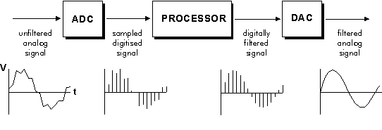
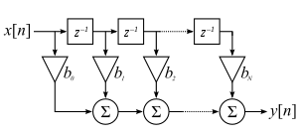
Intro to DSP Filters
June 2020

Slide 2

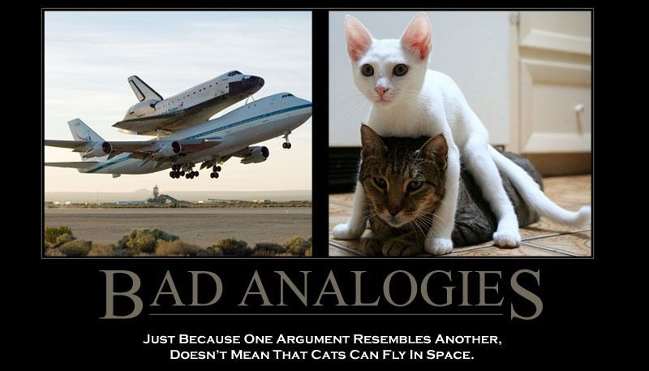
Rules of thumb, assumptions and mixed-quality analogies to come!

Slide 3
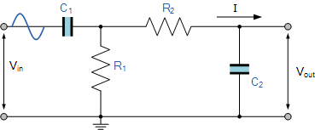
What is a DSP Filter?
≠ Analog Signal Processing
Input
Output
DSP = Digital Signal Processing
Input
Fancy
Microprocessor
Output

Slide 4
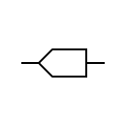

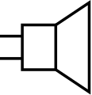
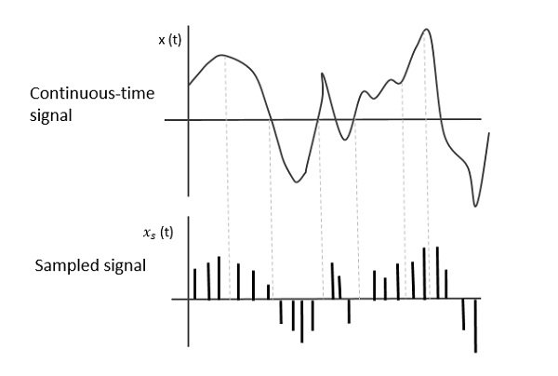
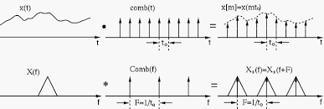
Audio Implementation
Fancy
Microprocessor
ADC
DAC

Slide 5
Why use Analog vs Digital Processing?
Analog:
Infinite bandwidth
Good for high frequency applications
Doesn’t require ADC, microprocessor
Can offload complexity from processor
Digital:
Can change filter characteristics easily
More ideal filters are possible
Can do types of processing that analog can’t
Data compression
Math operations like cos(), atan()
Pattern recognition, red-eye reduction
Lots of specific knowledge (Nyquist sample rates, quantization noise, etc.)

Slide 6
Where is DSP Used
Radars
Sonars
Speech Recognition
Image Processing
Channel Equalization
Medical Imaging
Speaker Crossovers
Mobile Phones (Speech Coding, Noise Reduction)

Slide 7
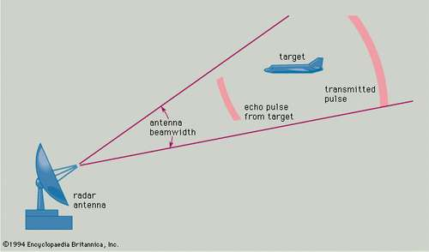
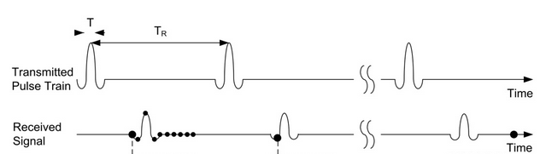
Ex: Radar Pulse Compression^{[1]}
Radar: emits a pulse of a specific shape and looks for a reflected pulse that matches that shape

Slide 8
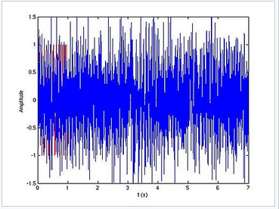
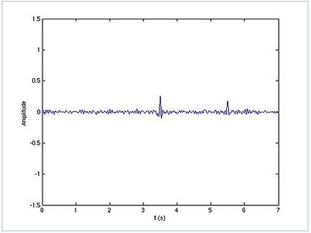
Ex: Radar Pulse Compression^{[2]}
“Matching Filter”:
Looks for correlation between received signals and the emitted pulse
Post-Processed Signal
Received Signal

Slide 9
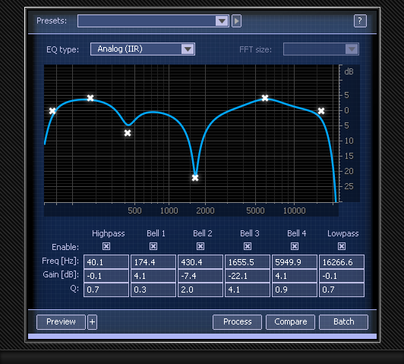
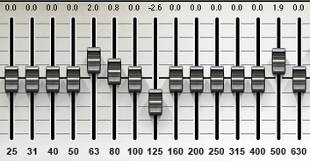
Ex: Parametric EQ ^{[3]}
DSP equalizer can allow the user to tailor frequency response nearly infinitely

Slide 10
How are DSP filters implemented?
x[0] | x[1] | x[2] | x[3] | x[4] | x[5] | x[6] | x[7] | x[8] | x[9]
* * *
w[0] | w[1] | w[2]
y[0]= x[0]*w[0] + x[1]*w[1] + x[2]*w[2]
y[0]

Slide 11
How are DSP filters implemented?
x[0] | x[1] | x[2] | x[3] | x[4] | x[5] | x[6] | x[7] | x[8] | x[9]
* * *
w[0] | w[1] | w[2]
y[0] | y[1]

Slide 12
How are DSP filters implemented?
x[0] | x[1] | x[2] | x[3] | x[4] | x[5] | x[6] | x[7] | x[8] | x[9]
* * *
w[0] | w[1] | w[2]
y[0] | y[1] | y[2]

Slide 13
How are DSP filters implemented?
x[0] | x[1] | x[2] | x[3] | x[4] | x[5] | x[6] | x[7] | x[8] | x[9]
* * *
w[0] | w[1] | w[2]
This is called “Convolution”
y[0] | y[1] | y[2] | y[3] | y[4] | y[5] | y[6] | y[7]

Slide 14
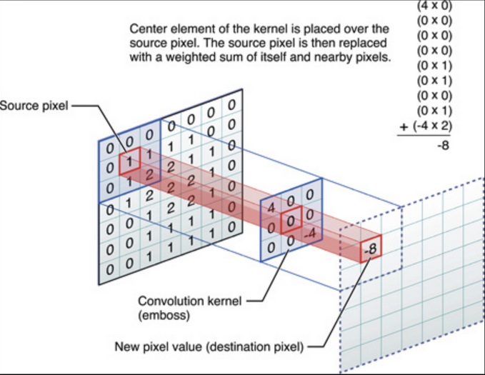
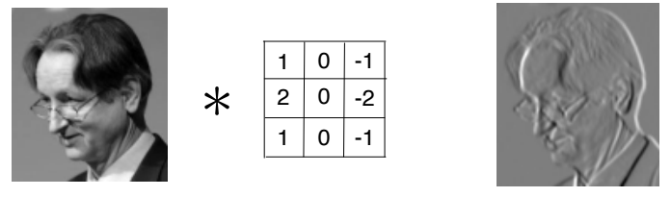
2D Convoluton Example^{[4][5]}

Slide 15
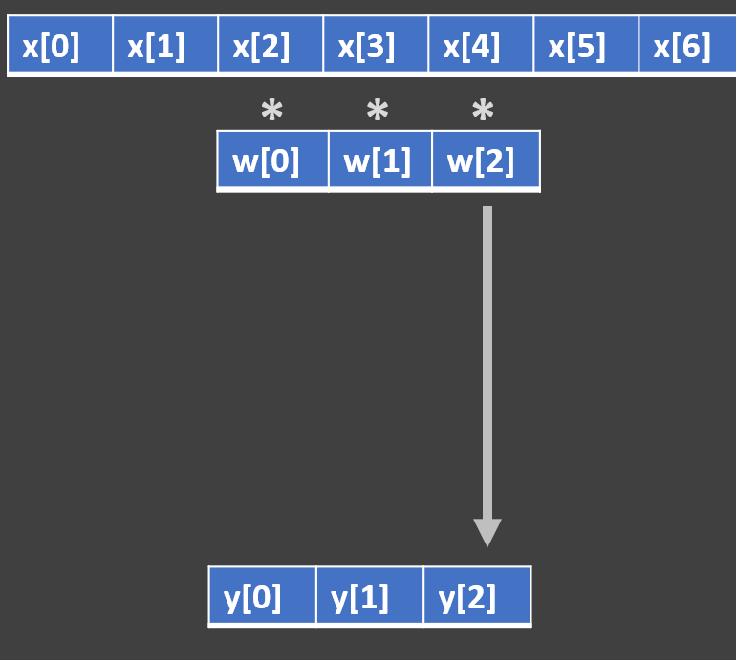
DSP Filter Block Diagram
X
X_{t}
X_{t-1}
Input
Signal
Delay 1 Sample
x1.0
X0.5
Summer
Output
Signal

Slide 16
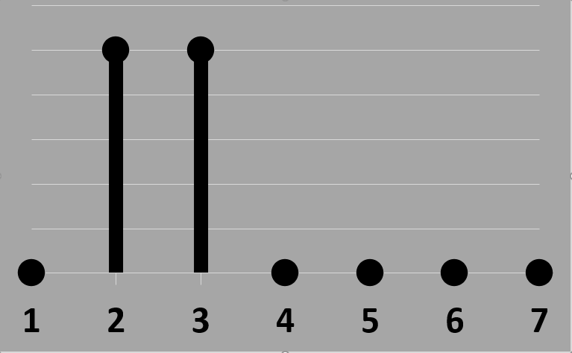
DSP Example
t=1
Time | Value
1 | 0
2
3
4
5
6
… | …
0
Delay
0
Time | Value
1 | 0
2 | 1
3 | 1
4 | 0
5 | 0
6 | 0
… | …
x0.5
X0.5
0
0
Summer
0
0+0=0
Output
Signal

Slide 17
DSP Example
t=2
Time | Value
1 | 0
2 | 0.5
3
4
5
6
… | …
1
Delay
0
Time | Value
1 | 0
2 | 1
3 | 1
4 | 0
5 | 0
6 | 0
… | …
x0.5
X0.5
0.5
0
Summer
0.5
0.5+0=0.5
Output
Signal

Slide 18
DSP Example
t=3
Time | Value
1 | 0
2 | 0.5
3 | 1
4
5
6
… | …
1
Delay
1
Time | Value
1 | 0
2 | 1
3 | 1
4 | 0
5 | 0
6 | 0
… | …
x0.5
X0.5
0.5
0.5
Summer
1
0.5+0.5=1
Output
Signal

Slide 19
DSP Example
t=4
Time | Value
1 | 0
2 | 0.5
3 | 1
4 | 0.5
5
6
… | …
0
Delay
1
Time | Value
1 | 0
2 | 1
3 | 1
4 | 0
5 | 0
6 | 0
… | …
x0.5
X0.5
0
0.5
Summer
0.5
0+0.5=0.5
Output
Signal

Slide 20
DSP Example
t=5
Time | Value
1 | 0
2 | 0.5
3 | 1
4 | 0.5
5 | 0
6
… | …
0
Delay
0
Time | Value
1 | 0
2 | 1
3 | 1
4 | 0
5 | 0
6 | 0
… | …
x0.5
X0.5
0
0
Summer
0
0+0=0
Output
Signal

Slide 21
DSP Example
t=5
Time | Value
1 | 0
2 | 0.5
3 | 1
4 | 0.5
5 | 0
6 | 0
… | …
0
Delay
0
Time | Value
1 | 0
2 | 1
3 | 1
4 | 0
5 | 0
6 | 0
… | …
x0.5
X0.5
0
0
Summer
0
0+0=0
Output
Signal

Slide 22
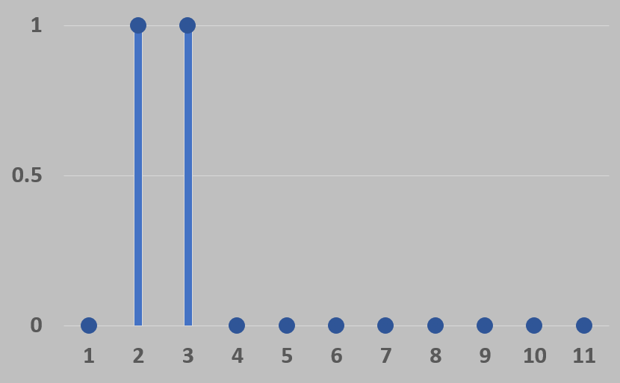
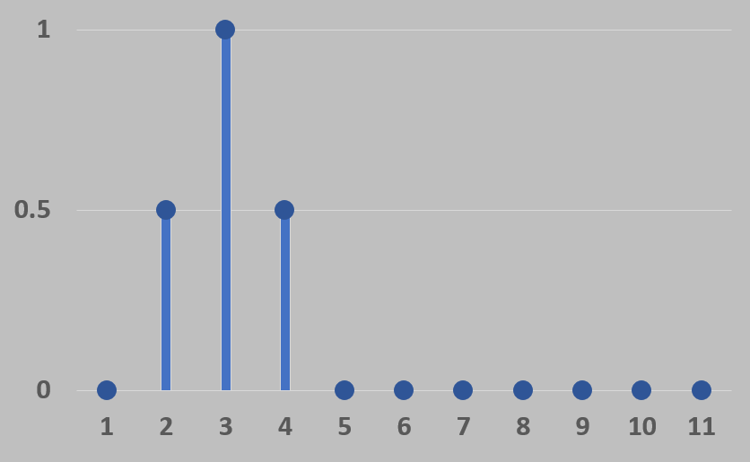
DSP Example Result

Slide 23
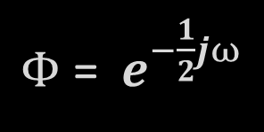

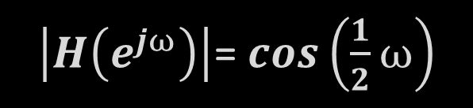

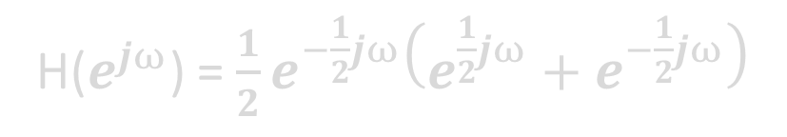

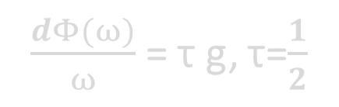
Fancy Maths – Please Ignore!
H(z) = $\frac{1}{2}+\frac{1}{2}z^{−1}$
H(z) = $\frac{1}{2}\left(\frac{z+1}{z}\right)$
H($e^{jω}$) =$\frac{1}{2}+\frac{1}{2}e^{−jω}$
H($e^{jω}$) =$\frac{1}{2}e^{−\frac{1}{2}jω}\left(e^{\frac{1}{2}jω}+e^{−\frac{1}{2}jω}\right)$
H($e^{jω}$) =$\frac{1}{2}e^{−\frac{1}{2}jω} cos\left(\frac{1}{2}ω\right)$
$\left|H\left(e^{jω}\right)\right|$=$cos\left(\frac{1}{2}ω\right)$
$Φ$= ${ e}^{−\frac{1}{2}jω}$
$\frac{dΦ(ω)}{ω}$= τ g, τ=$\frac{1}{2}$
Frequency
Domain
Response
Phase Response
Group Delay Response

Slide 24
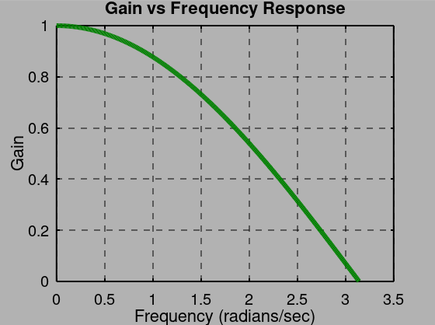
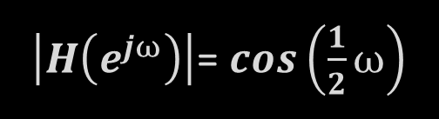
Frequency Response Plot
$\left|H\left(e^{jω}\right)\right|$=$cos\left(\frac{1}{2}ω\right)$
Input
T
X0.5
X0.5
∑
Output

Slide 25
Normalized Frequency
π = Nyquist Frequency
= ½ Sample Rate
If we sampled at 10kHz
Then π = 5kHz

Slide 26
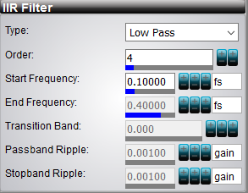
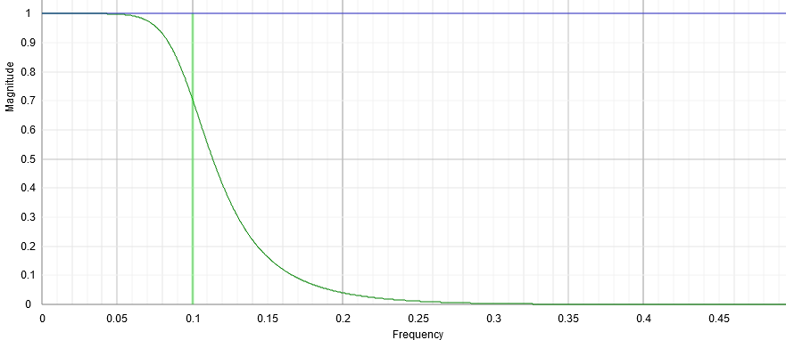
Practical – Use Calculator^{[6]}
Set filter properties

Slide 27
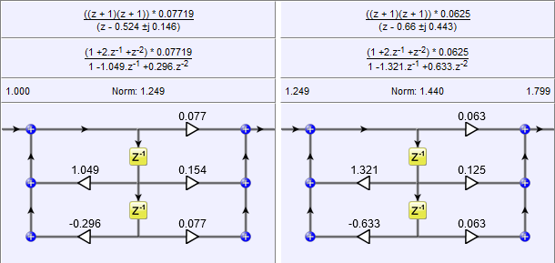
Practical – Use Calculator^{[6]}
Get block diagram

Slide 28
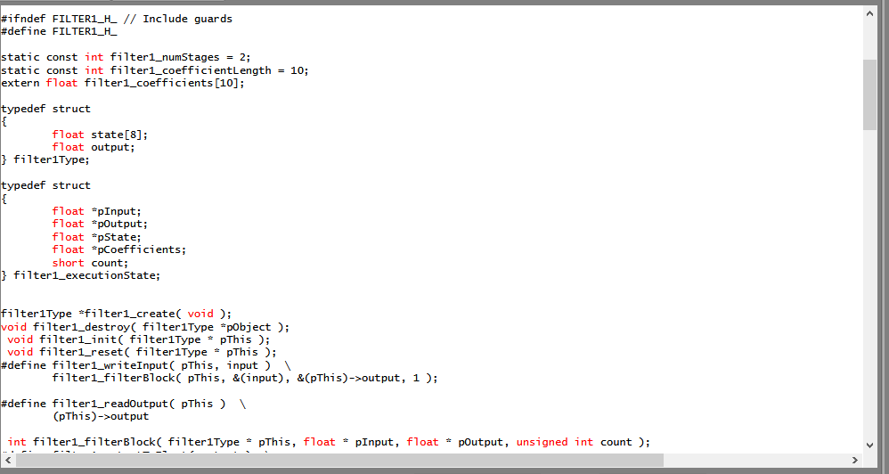
Practical – Use Calculator^{[6]}
Copy generated code

Slide 29
DSP Microprocessors^{[7]} ^{Fast Multiply-Accumulate}
Oriented towards fast execution of multiply/add of a series of filter coefficients and sample data points
SHARC DSP:
One clock cycle: multiply, add, 2 data moves, update 2 circular buffer pointers, loop control
A 100 tap FIR filter is executed in 105-110 cycles
Traditional CPU, several thousand cycles

Slide 30
DSP Microprocessors^{[7]} ^{Circular Buffers}
Address | Sample Value | Time
10000 | 0.0544 | x[n-4]
10001 | 0.1827 | x[n-3]
10002 | 0.3488 | x[n-2]
10003 | 0.8447 | x[n-1]
10004 | 0.3712 | x[n]
10005 | 0.3947 | x[n-7]
10006 | 0.7640 | x[n-6]
10007 | 0.6671 | x[n-5]
Circular Buffer
Holds sampled data
New data point rolls in
Oldest point rolls out
Extremely fast updates
V
Newest
Oldest

Slide 31
DSP Microprocessors^{[7]} ^{Extended Precision Accumulator}
Typical 16 processor -> 16 bit accumulator
A 10 tap filter means 10 adds. To prevent overflow we scale the numbers by 1/10.
Now the signal strength has been reduced by 90%
Worsens signal to noise ratio dramatically for filters with large operations
A DSP processor would have a 32 – 40 bit accumulator

Slide 32
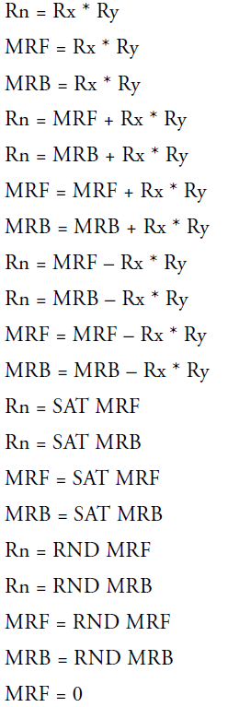

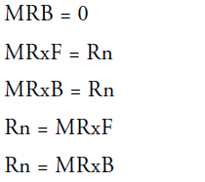
DSP Microprocessors ^{Floating vs Fixed Point}
ADSP-21161: Ways to multiply 2 numbers
Fixed
Float
Fixed -> cheaper
Floating -> better and easier

Slide 33
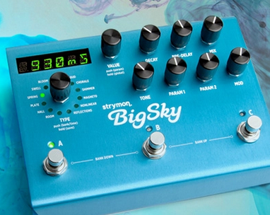
Guitar Effects Processor
Strymon BigSky effects processor - Analog Devices SHARC running at 366MHz
Samples at 96,000 samples/second
3,800 operations per sample (e.g. multiple/add)

Slide 34
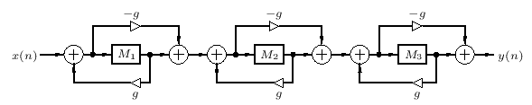
Artificial Reverb^{[8]}
Typically use “Schroeder Allpass Sections”
g is less than 1 (typically ~0.7)

Slide 35
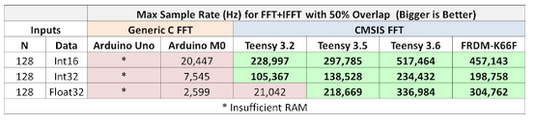
Computational Loads^{[9]}
5G Application:
CEVA-XC Gen 4: 1.8GHz, 7nm, 1.6 teraflops/sec
Audio: hi-fidelity, looking for 44kHz:

Slide 36
References
[1] https://www.intechopen.com/books/radar-technology/radar-performance-of-ultra-wideband-waveforms
[2] https://en.wikipedia.org/wiki/Pulse_compression
[3] http://help.izotope.com/docs/rx/pages/reference_parametricequalizer.htm
[4] https://leonardoaraujosantos.gitbooks.io/artificial-inteligence/content/convolution.html
[5] https://medium.com/@james.chain1990/study-3d-convolutional-neural-networks-for-human-action-recognition-7eaeb9a0ec00
[6] https://www.micromodeler.com/dsp/
[7] http://www.dspguide.com/ch28/3.htm
[8] https://ccrma.stanford.edu/~jos/pasp/Schroeder_Allpass_Sections.html
[9] http://openaudio.blogspot.com/2016/10/benchmarking-teensy-36-is-fast.html

